Slide 1



CONSUMER GOODS AD-HOC INSIGHTS
By: Deepti Nag
Design by Freepik.com

Slide 2










ABOUT ATLIQ HARDWARE
ATLIQ HARDWARE
Fiscal year : September to August
Notes:
Peripherals segment--keyboard, mouse, monitor || Accessories--cases, cooling solutions, power supplies || laptops|| desktops|| storage-- hard disks, SSDs, external storage ||Networking--routers, switches, modem

Slide 3

Atliq Hardware Global Market Presence
Canada
Germany
United States of America
China
Japan
Pakistan
Bangladesh
Philippines
Columbia
India
Brazil
Australia
New Zealand
Notes:
Regions– APAC, EU, NA,LA

Slide 4






Platform
Channels
Retailer
Direct
Brick and Mortar (offline)
Distributer
E- Commerce (online)

Slide 5
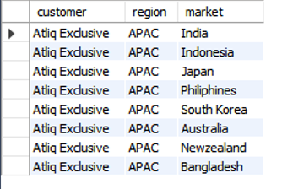
Atliq Exclusive Market Operation
AD HOC REQUEST 1
OUTPUT
Provide the list of markets in which customer "Atliq Exclusive" operates its business in the APAC region.

Slide 6
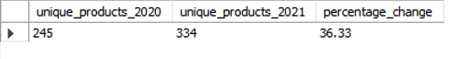
Yearly Increase in Unique Products
AD HOC REQUEST 2
OUTPUT
What is the percentage of unique product increase in 2021 vs. 2020? The final output contains these fields, unique_products_2020
unique_products_2021
percentage_chg

Slide 7
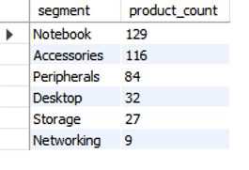
Report of Unique Products per Segment
AD HOC REQUEST 3
OUTPUT
Provide a report with all the unique product counts for each segment and sort them in descending order of product counts. The final output contains 2 fields, segment product_count

Slide 8
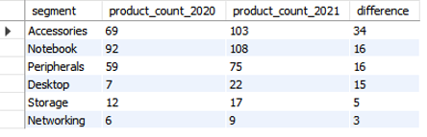
Segment - wise Increase in Unique Products
AD HOC REQUEST 4
OUTPUT
Follow-up: Which segment had the most increase in unique products in 2021 vs 2020? The final output contains these fields,
segment product_count_2020
product_count_2021
difference

Slide 9
Highest and Lowest Manufacturing Cost
AD HOC REQUEST 5
OUTPUT
Get the products that have the highest and lowest manufacturing costs. The final output should contain these fields,
product_code
product
manufacturing_cost
Notes:
A6120110206--PC div--Desktop segment--Personal Desktop category
A2118150101--P & A div—Accessories segment –Mouse category

Slide 10
Top 5 Customers Receiving Average High Pre Invoice Discount percentage
AD HOC REQUEST 6
OUTPUT
Generate a report which contains the top 5 customers who received an average high pre_invoice_discount_pct for the fiscal year 2021 and in the Indian market. The final output contains these fields,
customer_code
customer
average_discount_percentage

Slide 11
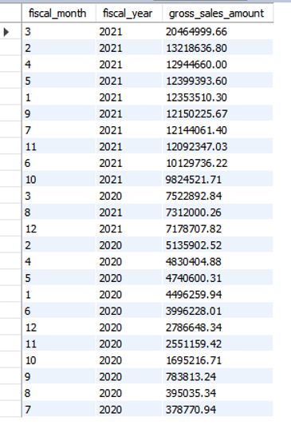
Monthly Gross Sales Report for Atliq Exclusive
AD HOC REQUEST 7
OUTPUT
Get the complete report of the Gross sales amount for the customer “Atliq Exclusive” for each month. This analysis helps to get an idea of low and high-performing months and take strategic decisions. The final report contains these columns: Month
Year
Gross sales Amount

Slide 12
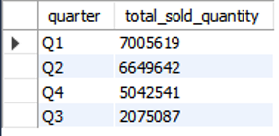
Quarter Showing Highest Total Sold Quantity In Fiscal Year 2020
AD HOC REQUEST 8
OUTPUT
In which quarter of 2020, got the maximum total_sold_quantity? The final output contains these fields sorted by the total_sold_quantity, Quarter
total_sold_quantity

Slide 13
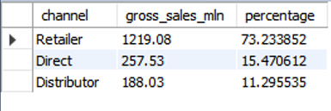
Channel-wise Gross Sales Report For Fiscal Year 2021
AD HOC REQUEST 9
OUTPUT
Which channel helped to bring more gross sales in the fiscal year 2021 and the percentage of contribution? The final output contains these fields, channel
gross_sales_mln
percentage

Slide 14
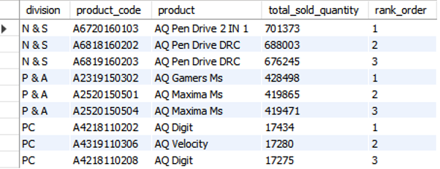
Top 3 Products In Demand Per Division In Fiscal Year 2021
AD HOC REQUEST 10
OUTPUT
Get the Top 3 products in each division that have a high total_sold_quantity in the fiscal_year 2021? The final output contains these fields, division
product_code
product
total_sold_quantity
rank_order

Slide 15
Thank You

